Slide 1
The Battle of Neighborhood (Abuja and Lagos)

Slide 2
Introduction: Business Problem
Nigeria is full of wonderful places for both business adventure and vacation trips. Many people dedicate themselves to explore Nigeria to know where is more suitable for business or for Vacation trips. This project seeks to explore venues in the cities of Abuja and Lagos, cluster them and reveal the different cities in terms of different venues categories. By the nature of this project, travel companies and their customers might be interested in this project to find similar and different places in Nigeria. Our case study will be Abuja and Lagos.

Slide 3
Introduction: Target Audience
Target audiences for this project does not limit to a person who keeps travelling but everyone. People could simply decide to look for a similar location to do vacation or get the best place in the state to go for vacation or business trip. So target for this project is basically everyone who is exploring different places or similar places.

Slide 4
Data
In order to accomplish this goal, the cities of each state with their latitudes and longitudes are required. The longitude and latitude of each locations in the state were computed manually as well as the cities of each state. From this data, I need to explore the venue category around these cities of Lagos and Abuja by utilizing Foursquare API.
Then I used the acquired location data to explore the venues from the Foursquare API. Using the "explore" option, I look for top 10 venue categories in 10 km radius for each city center and I get "Venue", "Venue Latitude", "Venue Longitude" and "Venue Category" columns.

Slide 5
Methodology
In this project we will direct our efforts on detecting the various kind of venue category in both states using the Foursquare API to get such information
The Foursquare API is used to retrieve all venues of each neighborhoods, then group by each neighborhoods and to count how many venues before filter top 10 most common venue types of each neighborhoods and then using the K Means clustering to cluster each venue Category

Slide 6
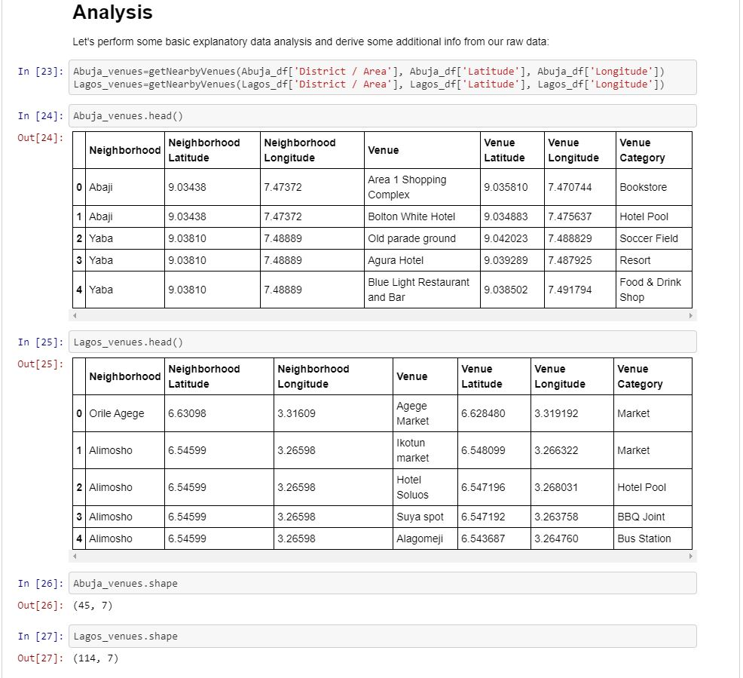
Results and Discussions
Lagos has more venues than Abuja (114 vs 45)

Slide 7
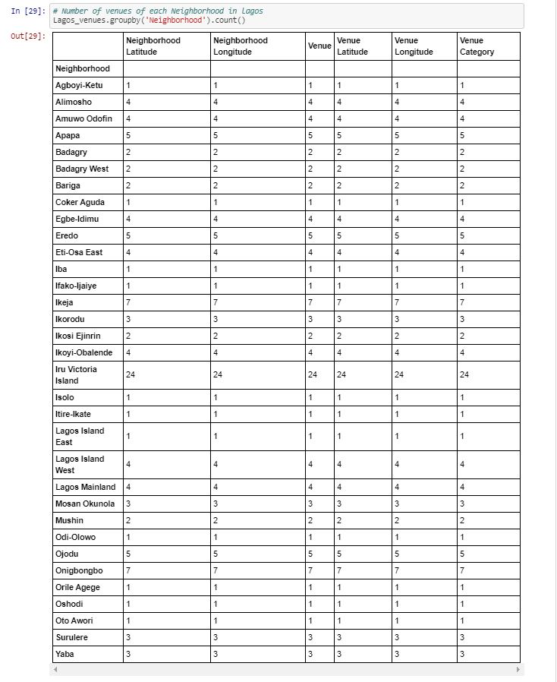
Results and Discussions – Cont’d
Victoria Island has the most venues in Lagos (24)

Slide 8
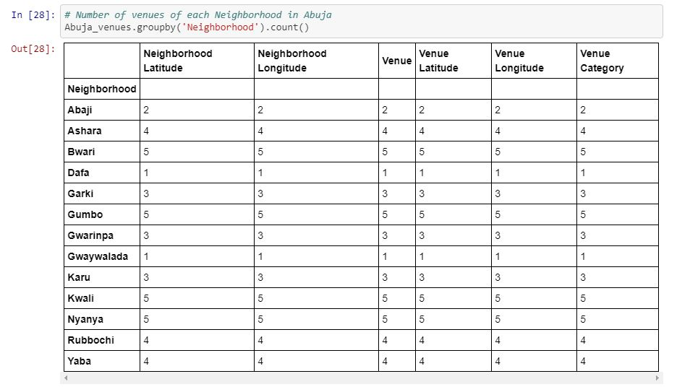
Results and Discussions – Cont’d
Bwari and Nyanya has the most venues in Abuja

Slide 9
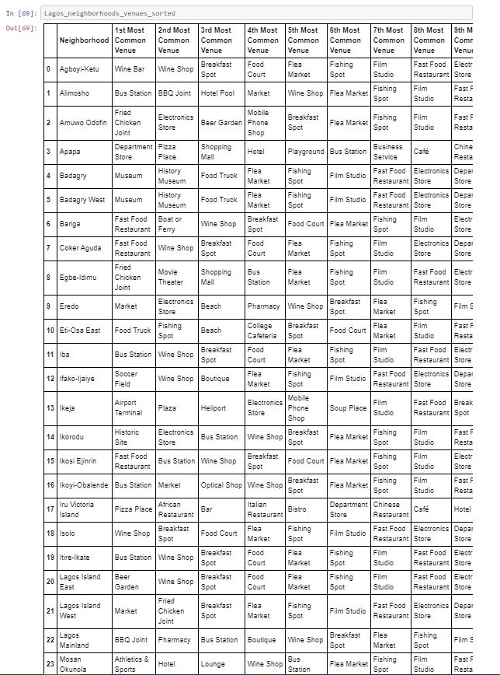
Results and Discussions – Cont’d
Most common venues in Victoria Island are Pizza Place and Restaurant

Slide 10
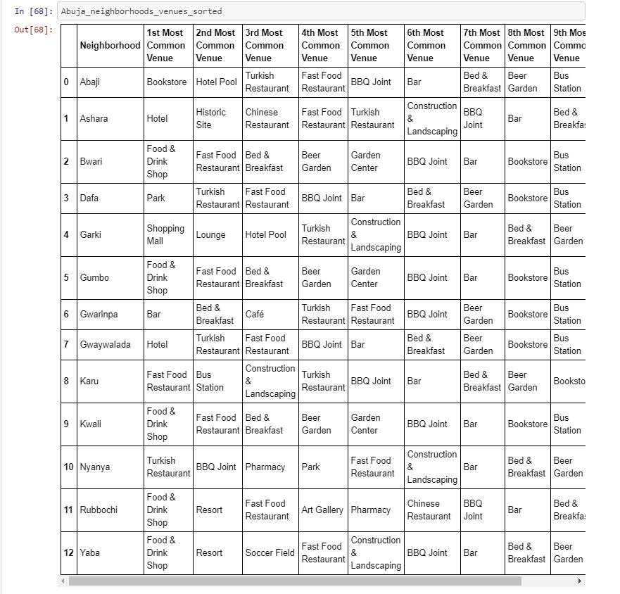
Results and Discussions – Cont’d
Venues in Nyanya and Bwari are more diverse includes: Pharmacy, Building and Construction, restaurants etc.

Slide 11
Results and Discussions – Cont’d
Bars, Restaurants, Bakeries, and Diners are very common in Abuja.
Lagos is more about commercial and also include Bars, Restaurants etc.

Slide 12
Conclusion
For travelers (vacation trips): Both states, Lagos and Abuja is more suitable to spend a good amount time of enjoy the local food
For business owners: Lagos is good place to open small business related to food and travel industry Lagos is better place to involve in industries Abuja is better place to open a firm

